Slide 1
USAF-558 - Supply Chain Communication
Carter Vannelli
Matthew Glos
Hao Wang
Ryan Becker
Liuhai Wang

Slide 2
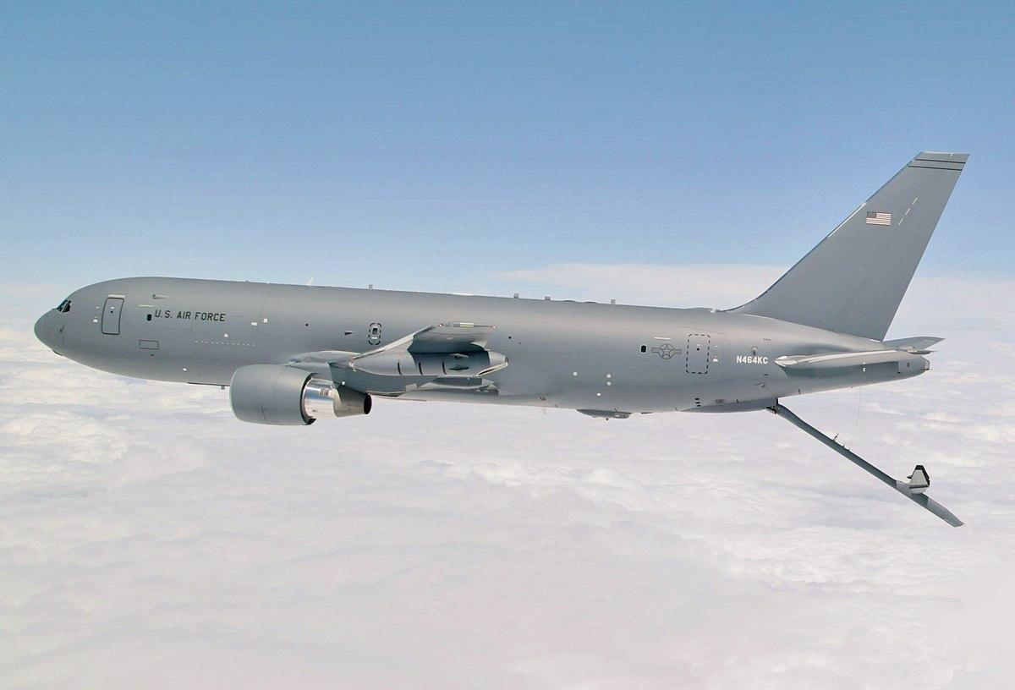
Introduction
Parts Ordering System
KC-46 Aircraft
Aar Mobility
Standardization
Operational Efficiency
COMBS Ordering System
Supplier Communication

Slide 3
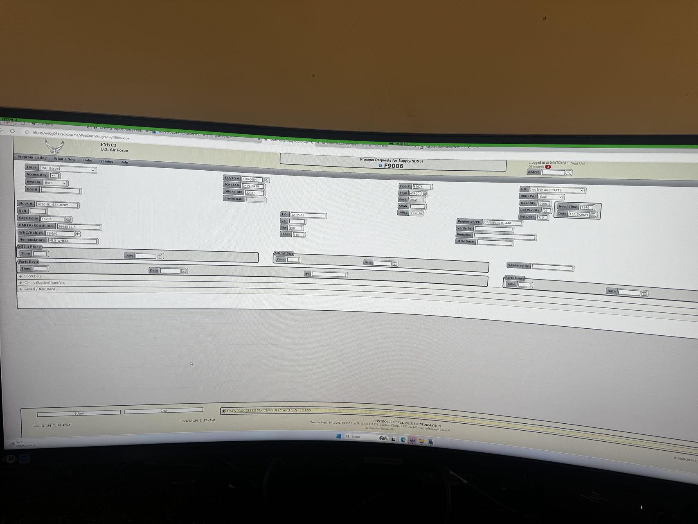
technical order system
Technical order system
Notes:
technical order system

Slide 4
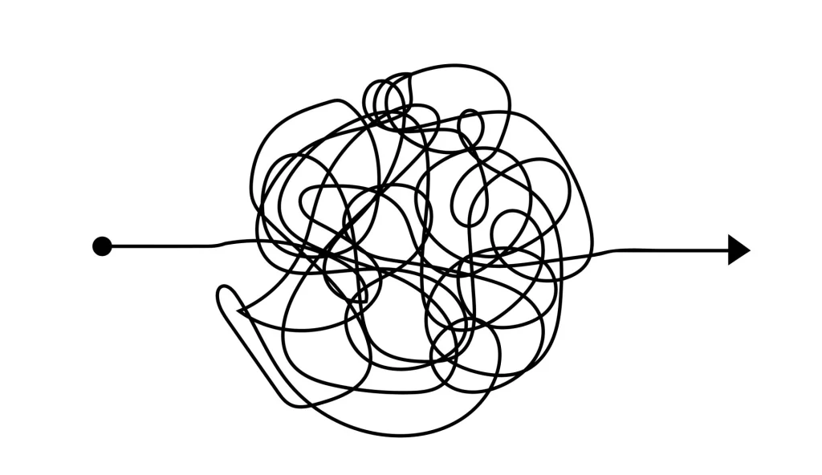
Parts Ordering Process
15 different ways to order
4 different systems
Besides, there are many complicated and confusing Problems
Notes:
Many complicated and confusing Problems: Whenever maintenance staffs are waiting for a part, the supplier gives them an estimated time, but it's usually wrong.
And, when staffs order a part and get something completely different? That's pretty common.
Because staffs spent all that time waiting for a part that they thought was the right one and it turns out not to be. That's a lot of wasted time.
The crew chief, the person who launches the airplane, will get the airplane ready four hours in advance to make sure it's ready to launch. Maintenance gets a call that they need to put Seat Pallets in the airplane, but all the Seat Pallets are broken and there's nothing to put on them. This may prevent the pilot from flying.
Boeing parts were supposed to go from their ordering system to the Air Force's ordering system, but they never did.

Slide 5
Beneficiary Discovery
KC-46 Crew Maintenance: Directly use the system for parts ordering and maintenance.
Logistics department: Responsible for material management and supply chain coordination.
Pilots and aircrew: Increased aircraft availability and smoother mission execution due to improved maintenance efficiency.

Slide 6
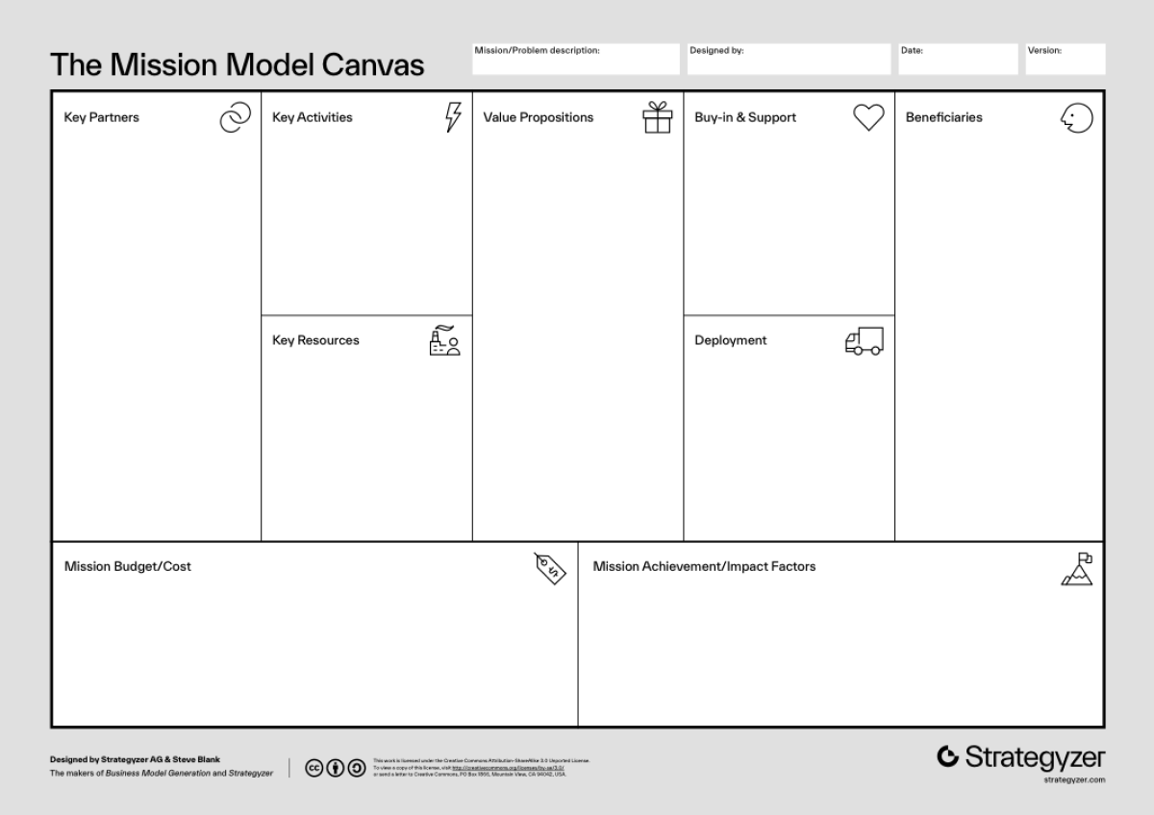
Mission Model Canvas
v3
USAF,
KC-46 Crew,
AAR Mobility Systems,
Boeing
?
Simplify the parts ordering process
Improving maintenance efficiency
Enhance inventory management
Improve part delivery reliability
KC-46 Crew,
AAR Mobility Systems,
USAF
KC 46 Aircraft Maintenance Squadron,
Aircraft Pilots,
Logistics Squadron,
Other members on the base
Technical order system
NSN database
G081 ordering system
AAR mobility catalogue
Phase 1: Research and Interviews
Phase 2: MVP development and testing
Software Development Costs
Hardware procurement
Staff training costs
Allow end-users to more efficiently inventory,
order, and maintain equipments

Slide 7
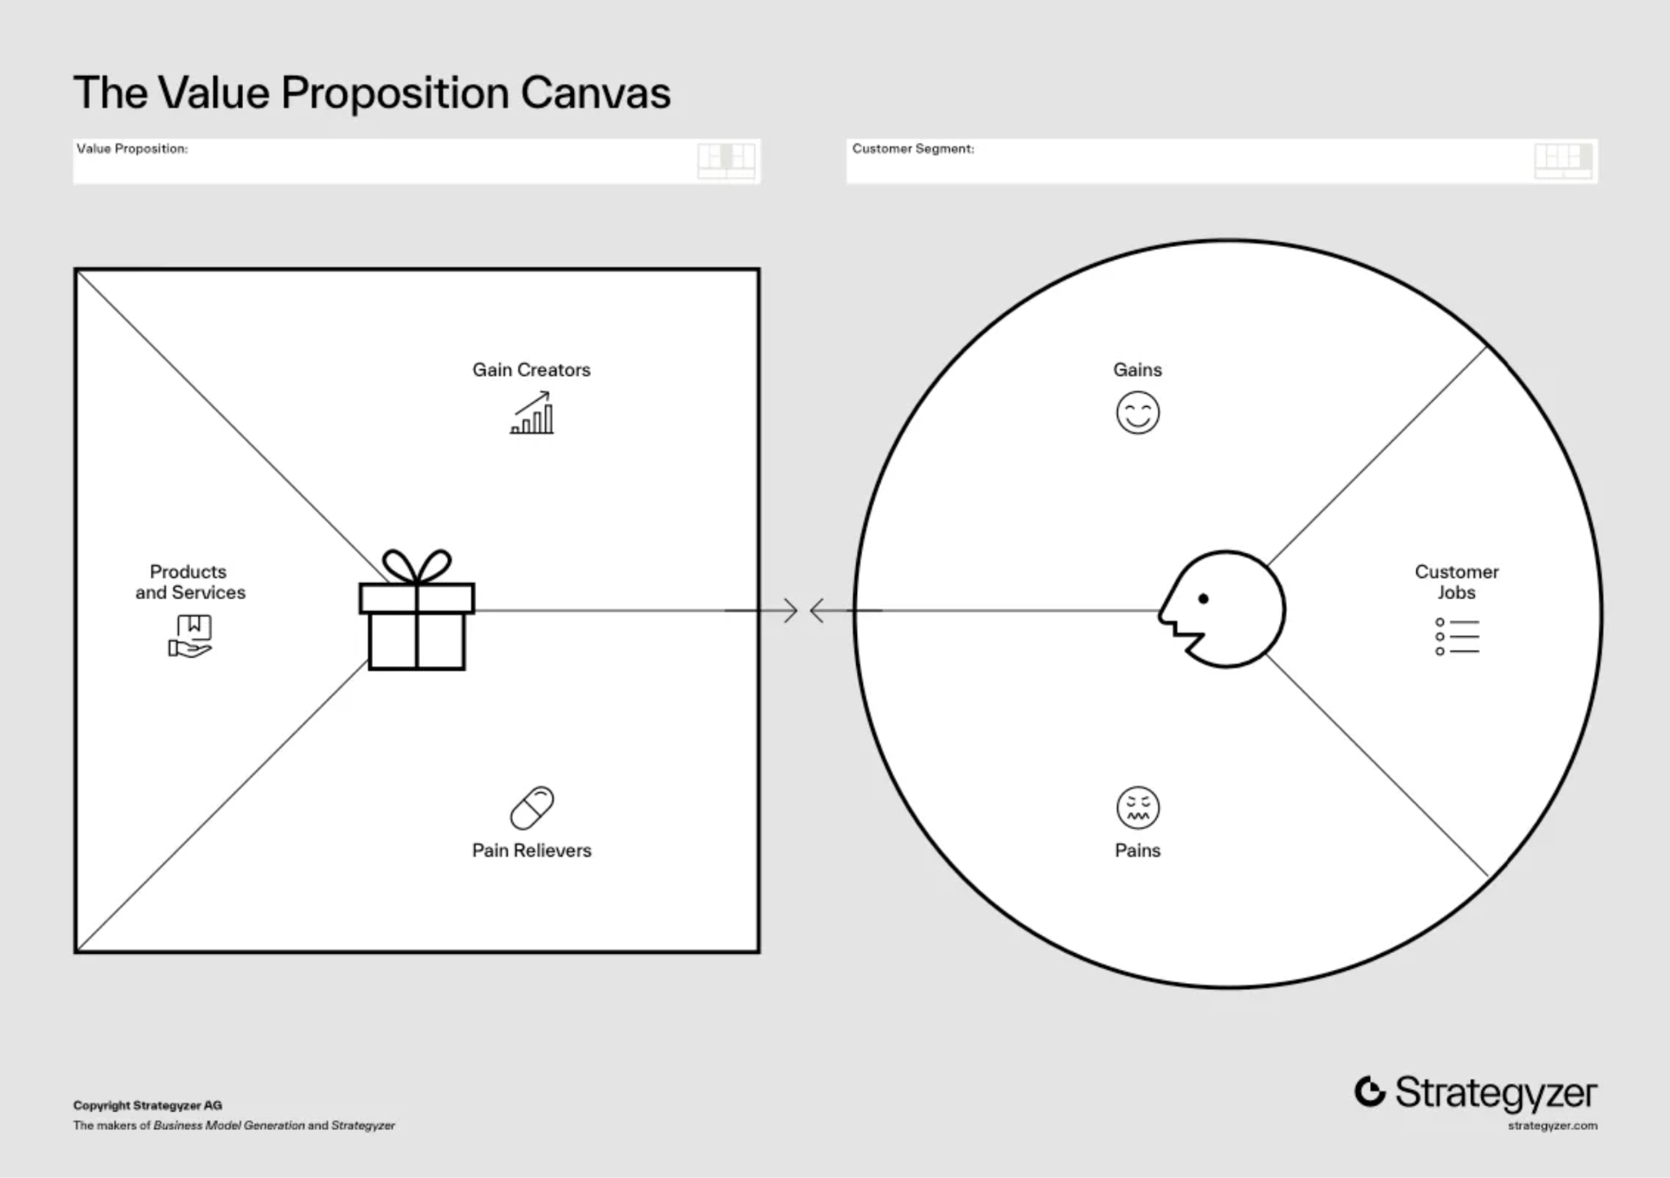
Value Proposition Canvas
Maintain and manage the KC-46 crew
Timely ordering and receiving of parts
Optimize inventory management
Improved efficiency of aircraft maintenance
Optimize inventory management
Complex parts ordering process
Excessive ordering time
Poor supply chain communication
Messy inventory management
Simplify the ordering process
Optimize supply chain communication
Enhance inventory management capabilities

Slide 8
What we learned this week
Interview maintenance staff in-depth to understand current pain points and needs in the parts ordering process.
Takeaways:
Clarified the complexity of the ordering process and missing information.

Slide 9

Potential Interviews & Experiments for Next Week
The whole squadron.
The employees from Boeing.
Notes:
The employees from Boeing. They had a lot of insight into the actual system and the workarounds they took to update the content.

